Slide 1
Multidimensional Arrays

Slide 2
Motivations
Thus far, you have used one-dimensional arrays to model linear collections of elements. You can use a two-dimensional array to represent a matrix or a table. For example, the following table that describes the distances between the cities can be represented using a two-dimensional array.

Slide 3
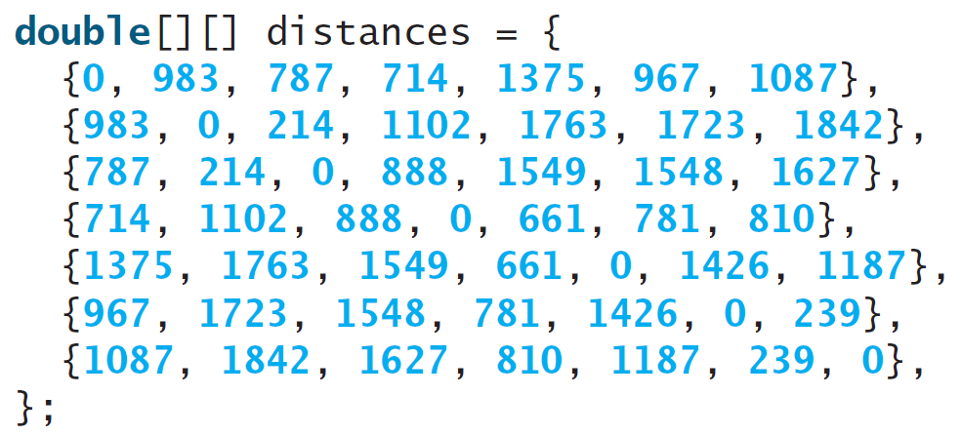
Motivations

Slide 4
Objectives
To give examples of representing data using two-dimensional arrays.
To declare variables for two-dimensional arrays, create arrays, and access array elements in a two-dimensional array using row and column indexes.
To program common operations for two-dimensional arrays (displaying arrays, summing all elements, finding the minimum and maximum elements, and random shuffling).
To pass two-dimensional arrays to methods.
To write a program for grading multiple-choice questions using two-dimensional arrays.
To solve the closest-pair problem using two-dimensional arrays.

Slide 5
Declare/Create Two-dimensional Arrays
// Declare array ref var
dataType[][] refVar;
// Create array and assign its reference to variable
refVar = new dataType[10][10];
// Combine declaration and creation in one statement
dataType[][] refVar = new dataType[10][10];
// Alternative syntax
dataType refVar[][] = new dataType[10][10];

Slide 6
Declaring Variables of Two-dimensional Arrays and Creating Two-dimensional Arrays
int[][] matrix = new int[10][10];
or
int matrix[][] = new int[10][10];
matrix[0][0] = 3;
for (int i = 0; i < matrix.length; i++)
for (int j = 0; j < matrix[i].length; j++)
matrix[i][j] = (int)(Math.random() * 1000);
double[][] x;

Slide 7
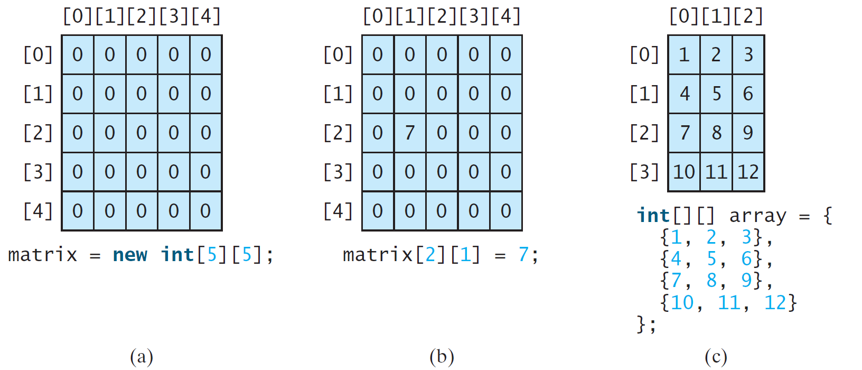
Two-dimensional Array Illustration
matrix.length? 5
matrix[0].length? 5
array.length? 4
array[0].length? 3

Slide 8
Declaring, Creating, and Initializing Using Shorthand Notations
You can also use an array initializer to declare, create and initialize a two-dimensional array. For example,
int[][] array = {
{1, 2, 3},
{4, 5, 6},
{7, 8, 9},
{10, 11, 12}
};
int[][] array = new int[4][3];
array[0][0] = 1; array[0][1] = 2; array[0][2] = 3;
array[1][0] = 4; array[1][1] = 5; array[1][2] = 6;
array[2][0] = 7; array[2][1] = 8; array[2][2] = 9;
array[3][0] = 10; array[3][1] = 11; array[3][2] = 12;
Same as

Slide 9
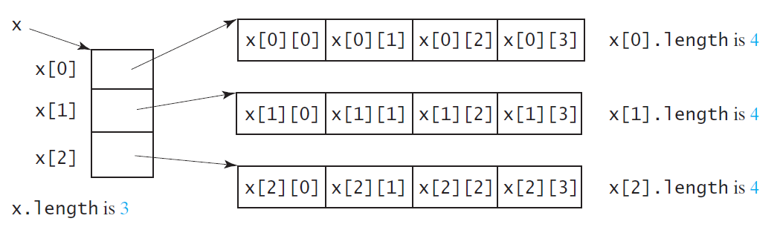
Lengths of Two-dimensional Arrays
int[][] x = new int[3][4];

Slide 10
Lengths of Two-dimensional Arrays, cont.
int[][] array = {
{1, 2, 3},
{4, 5, 6},
{7, 8, 9},
{10, 11, 12}
};
array.length
array[0].length
array[1].length
array[2].length
array[3].length
array[4].length ArrayIndexOutOfBoundsException

Slide 11
Processing Two-Dimensional Arrays
See the examples in the text.
(Initializing arrays with input values)
(Printing arrays)
(Summing all elements)
(Summing all elements by column)
(Which row has the largest sum)
(Finding the smallest index of the largest element)
(Random shuffling)

Slide 12
Initializing arrays with input values
java.util.Scanner input = new Scanner(System.in);
System.out.println("Enter " + matrix.length + " rows and " +
matrix[0].length + " columns: ");
for (int row = 0; row < matrix.length; row++) {
for (int column = 0; column < matrix[row].length; column++) {
matrix[row][column] = input.nextInt();
}
}

Slide 13
Initializing arrays with random values
for (int row = 0; row < matrix.length; row++) {
for (int column = 0; column < matrix[row].length; column++) {
matrix[row][column] = (int)(Math.random() * 100);
}
}

Slide 14
Printing arrays
for (int row = 0; row < matrix.length; row++) {
for (int column = 0; column < matrix[row].length; column++) {
System.out.print(matrix[row][column] + " ");
}
System.out.println();
}

Slide 15
Summing all elements
int total = 0;
for (int row = 0; row < matrix.length; row++) {
for (int column = 0; column < matrix[row].length; column++) {
total += matrix[row][column];
}
}

Slide 16
Summing elements by column
for (int column = 0; column < matrix[0].length; column++) {
int total = 0;
for (int row = 0; row < matrix.length; row++)
total += matrix[row][column];
System.out.println("Sum for column " + column + " is "
+ total);
}

Slide 17
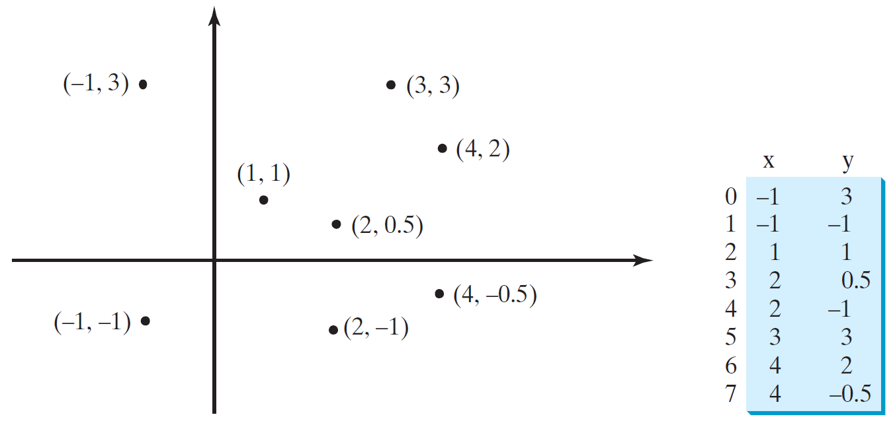
Problem: Finding Two Points Nearest to Each Other
FindNearestPoints
Run

Slide 18
Problem: Calculating Total Scores
Objective: write a program that calculates the total score for students in a class. Suppose the scores are stored in a three-dimensional array named scores. The first index in scores refers to a student, the second refers to an exam, and the third refers to the part of the exam. Suppose there are 7 students, 5 exams, and each exam has two parts--the multiple-choice part and the programming part. So, scores[i][j][0] represents the score on the multiple-choice part for the i’s student on the j’s exam. Your program displays the total score for each student.
TotalScore
Run

Slide 19
Problem: Weather Information
Suppose a meteorology station records the temperature and humidity at each hour of every day and stores the data for the past ten days in a text file named weather.txt. Each line of the file consists of four numbers that indicate the day, hour, temperature, and humidity. Your task is to write a program that calculates the average daily temperature and humidity for the 10 days.
Weather
Run

